Slide 1
Task 1 Recap
Introduction to task 1
Overview of task 1 objectives
Explanation of task 1 deliverables

Slide 2

Business Context
The business context of a project refers to the environment in which the project will operate.
This includes factors such as the company's goals, the competitive landscape, and market trends.
Understanding the business context is crucial in order to ensure that the solution aligns with the company's overall strategy.
Notes:
In order to develop a successful solution, it is important to understand the business context in which it will operate. This includes factors such as the company's goals, the competitive landscape, and market trends. By taking these factors into consideration, we can ensure that the solution aligns with the company's overall strategy.

Slide 3

Functional and Non-Functional Requirements
Functional requirements refer to what the system should do.
Non-functional requirements refer to how well the system should do it.
Examples of functional requirements include features, usability, and performance. Examples of non-functional requirements include reliability, security, and scalability.
Notes:
Functional and non-functional requirements are both important aspects of any software solution. Functional requirements refer to what the system should do, while non-functional requirements refer to how well the system should do it. Examples of functional requirements include features, usability, and performance, while examples of non-functional requirements include reliability, security, and scalability.

Slide 4
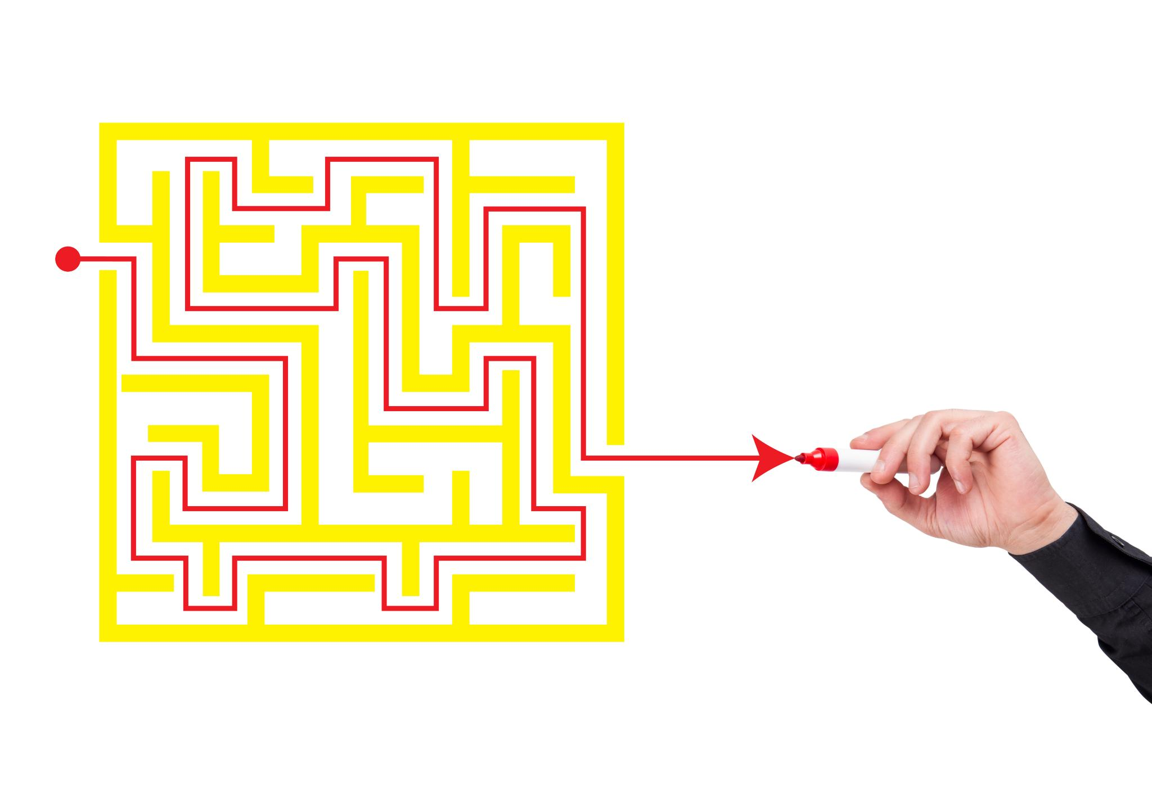
Problem Decomposition
Problem decomposition involves breaking down a complex problem into smaller, more manageable parts.
By breaking down a problem, it becomes easier to identify the root cause of an issue and develop appropriate solutions.
Problem decomposition is important in order to ensure that the solution addresses all aspects of the problem and doesn't just address symptoms.
Notes:
Problem decomposition is an important part of any software development project. It involves breaking down a complex problem into smaller, more manageable parts. By doing this, it becomes easier to identify the root cause of an issue and develop appropriate solutions. This helps to ensure that the solution addresses all aspects of the problem and doesn't just address symptoms.

Slide 5

Key Performance Indicators (KPIs) and User Acceptance Criteria
Key Performance Indicators (KPIs) are measurable values that indicate how well a system is performing.
User acceptance criteria are the set of conditions that a system must meet in order to be accepted by the end user.
Developing KPIs and user acceptance criteria is important in order to ensure that the system meets the needs of the end user and performs well.
Notes:
Developing Key Performance Indicators (KPIs) and user acceptance criteria is an important part of any software development project. KPIs are measurable values that indicate how well a system is performing, while user acceptance criteria are the set of conditions that a system must meet in order to be accepted by the end user. By developing these criteria, we can ensure that the system meets the needs of the end user and performs well.

Slide 6
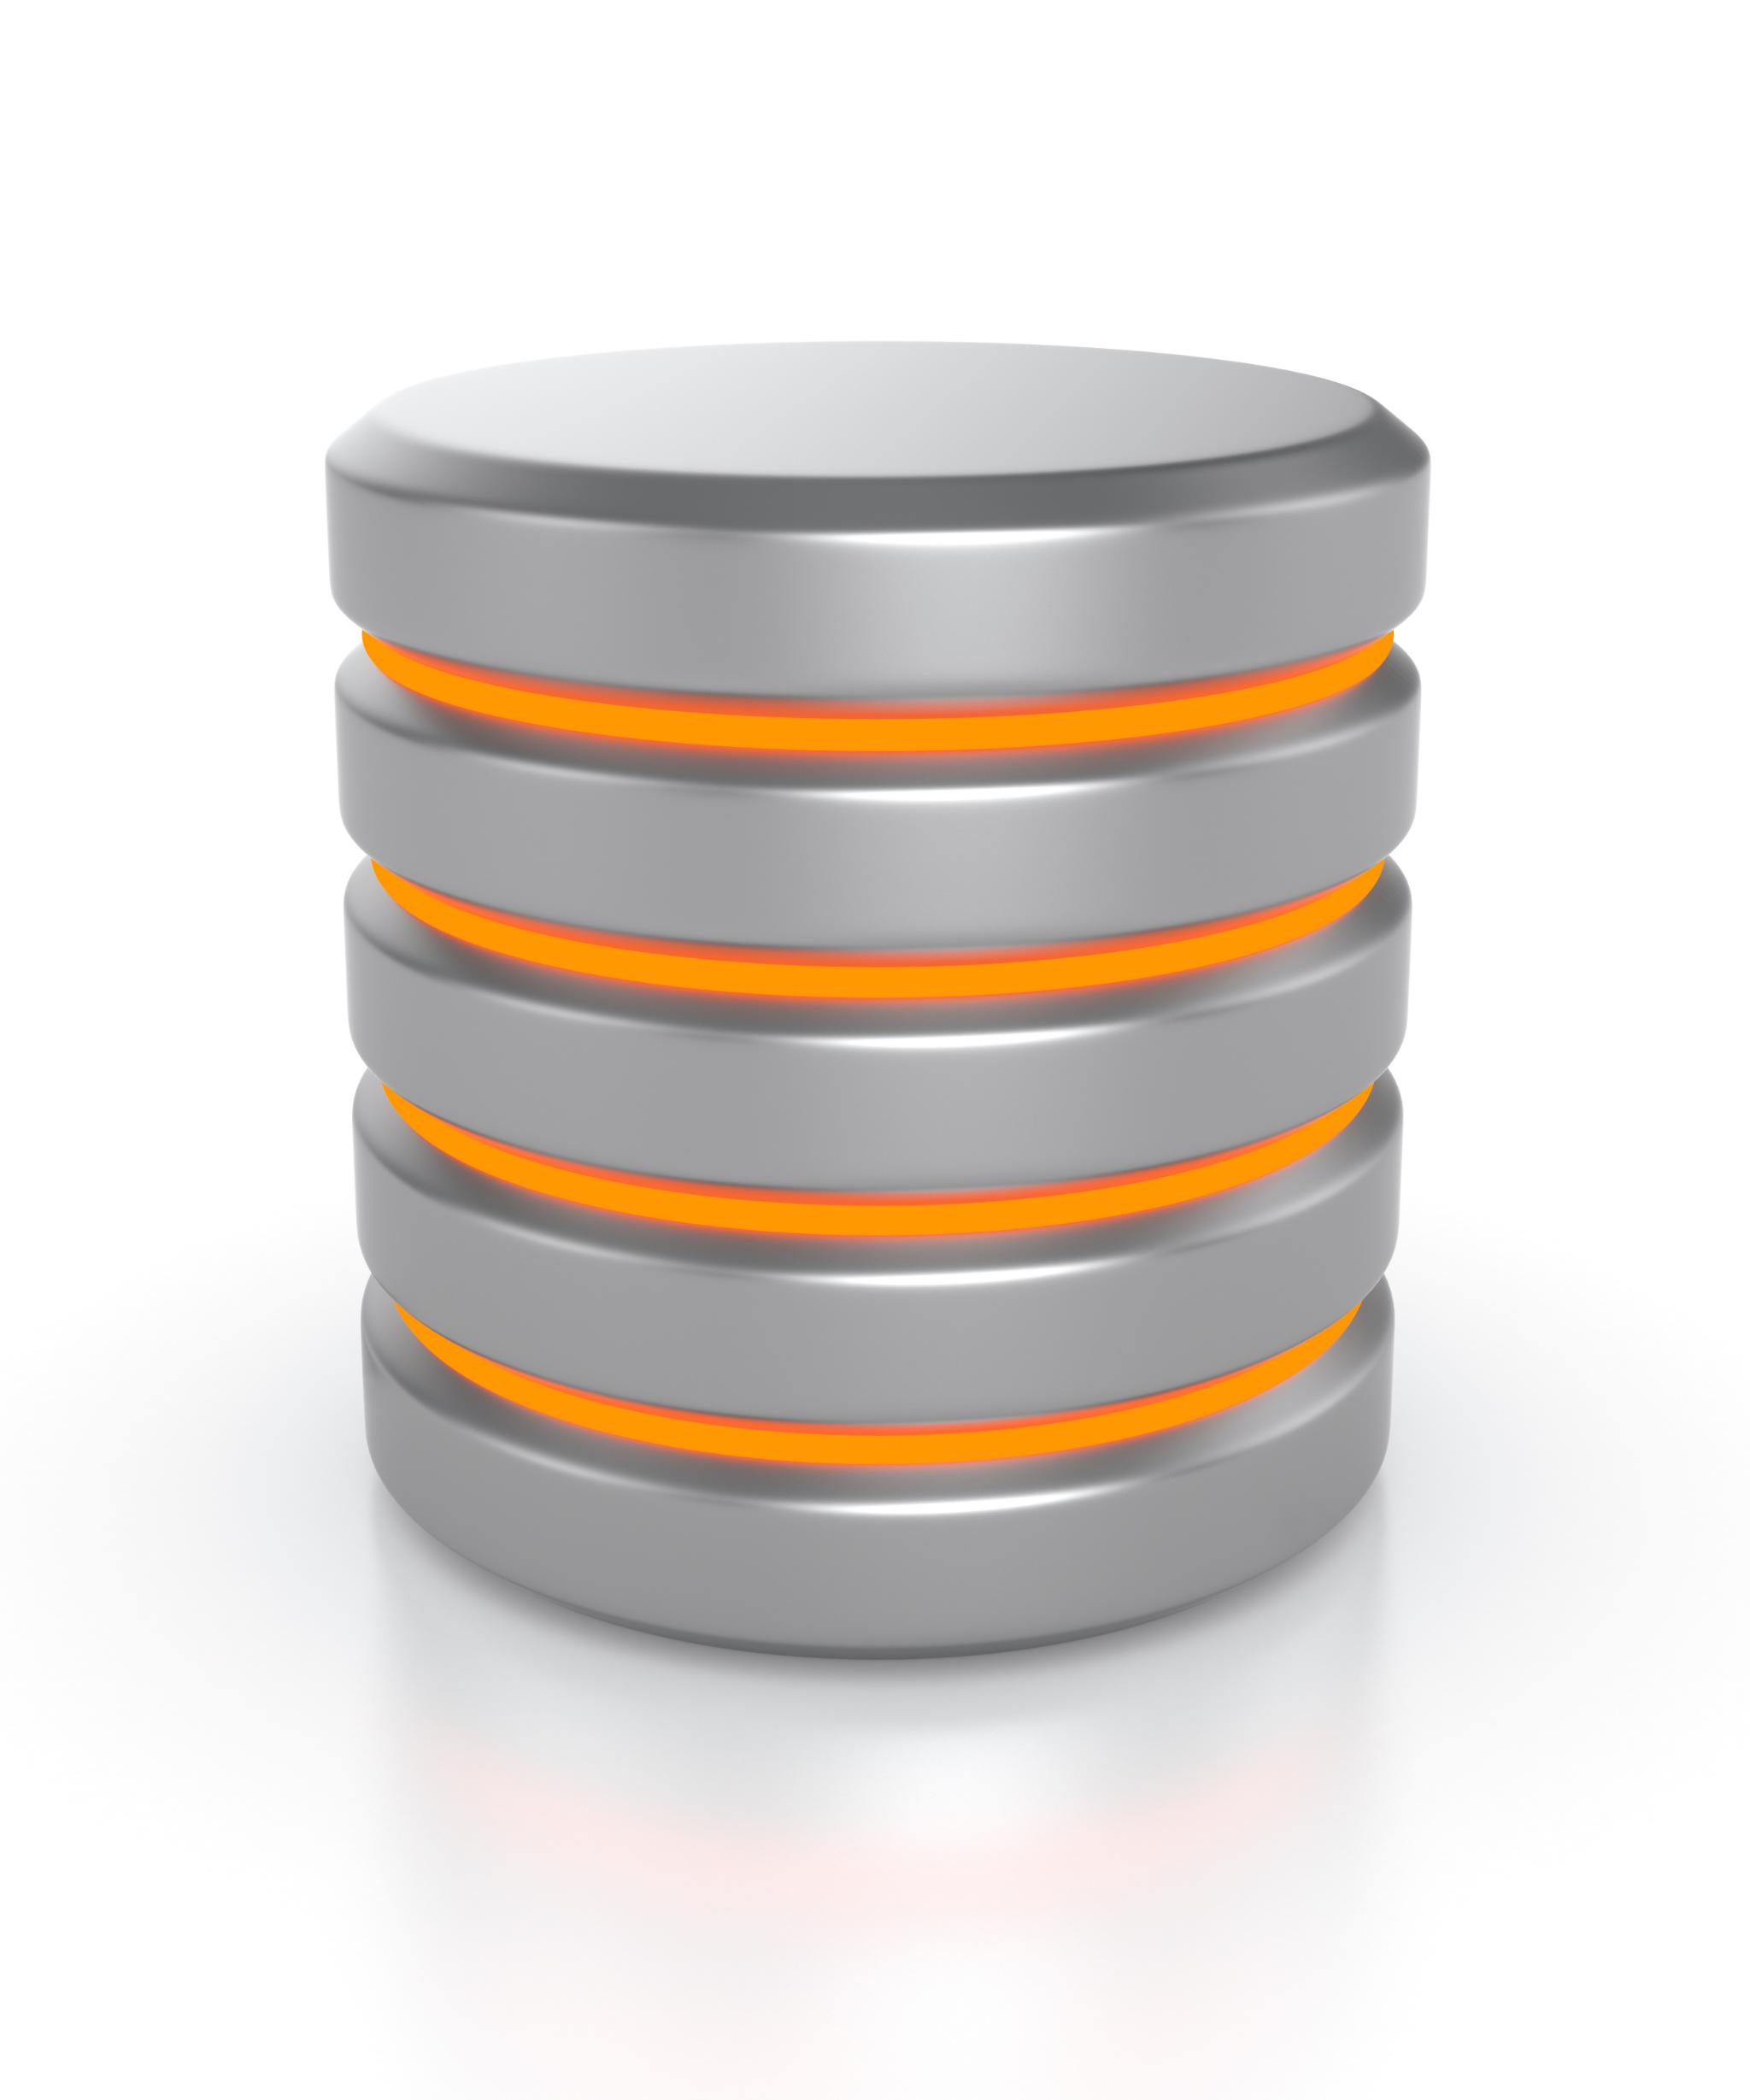
Description of Proposed Solution
The description of the proposed solution should explain how the system will work and how it will meet the identified requirements.
This should include details such as the system architecture, technologies used, and how data will be stored and accessed.
The description of the proposed solution should be clear and concise, and should be understandable by both technical and non-technical stakeholders.
Notes:
The description of the proposed solution is an important part of any software development project. It should explain how the system will work and how it will meet the identified requirements. This should include details such as the system architecture, technologies used, and how data will be stored and accessed. The description should be clear and concise, and should be understandable by both technical and non-technical stakeholders.

Slide 7

Justification of Recommended Solution
The justification of the recommended solution should explain why the proposed solution is the best option for the project.
This should include a comparison of the proposed solution with alternative solutions, and an explanation of how the proposed solution meets the identified requirements.
The justification should also explain how potential risks will be mitigated, and how relevant regulatory guidelines and legal requirements will be addressed.
Notes:
It is important to provide a justification for the recommended solution in order to ensure that stakeholders understand why it was chosen. This justification should include a comparison of the proposed solution with alternative solutions, an explanation of how the proposed solution meets the identified requirements, and an explanation of how potential risks will be mitigated. Additionally, the justification should explain how relevant regulatory guidelines and legal requirements will be addressed.

Slide 8

Risk Mitigation
Risk mitigation involves identifying potential risks and developing strategies to minimize their impact.
Identifying and mitigating risks is important in order to prevent delays and unexpected costs in the project.
Risk mitigation should be an ongoing process throughout the project, and should be revisited as new risks emerge.
Notes:
Risk mitigation is an important part of any software development project. It involves identifying potential risks and developing strategies to minimize their impact. This is important in order to prevent delays and unexpected costs in the project. Risk mitigation should be an ongoing process throughout the project, and should be revisited as new risks emerge.

Slide 9

Regulatory and Legal Compliance
Regulatory and legal compliance is an important consideration in any software development project.
This involves ensuring that the system meets all relevant regulations and legal requirements, such as data privacy laws.
Non-compliance with regulatory and legal requirements can lead to fines, legal action, and damage to the company's reputation.
Notes:
Regulatory and legal compliance is an important consideration in any software development project. It involves ensuring that the system meets all relevant regulations and legal requirements, such as data privacy laws. Non-compliance with regulatory and legal requirements can lead to fines, legal action, and damage to the company's reputation. It is important to address these issues early in the project and to regularly revisit them to ensure continued compliance.

Slide 10

Visual/Interface Designs
Visual design refers to the aesthetics and overall look and feel of a software application.
Interface design is concerned with the usability and functionality of the interface.
A good visual and interface design can lead to increased user engagement and satisfaction.
Notes:
Visual and interface design are key considerations in software development. A good design can make a big difference in the success of a product. Visual design is concerned with the aesthetics and overall look and feel of the application, while interface design is focused on usability and functionality. By considering both of these aspects, developers can create software that is both visually appealing and easy to use.

Slide 11

Data Requirements
Data requirements refer to the types and amount of data that needs to be processed by the system.
Understanding data requirements is crucial in order to develop a system that can handle the required data.
Data requirements can involve issues like data storage, retrieval, and processing.
Notes:
Data requirements are a critical aspect of software development. Understanding the types and amount of data that a system will need to handle is essential in order to design a system that can handle that data. Data requirements can involve issues such as data storage, retrieval, and processing. By considering these issues early in the development process, developers can avoid potential issues down the road.

Slide 12

Algorithm Designs
Algorithm design refers to the process of creating a step-by-step procedure for solving a problem.
Algorithm design is an important part of software development, particularly in areas like machine learning and data analysis.
Good algorithm design can lead to more accurate and efficient processing of data.
Notes:
Algorithm design is an essential part of software development, particularly in areas like machine learning and data analysis. By breaking down complex problems into smaller, more manageable parts, developers can create efficient and accurate algorithms that can process large amounts of data. Good algorithm design can make a big difference in the success of a product, and it is an area that developers should pay close attention to.

Slide 13

Test Strategy
A test strategy is a plan for testing a software application.
A good test strategy should cover both functional and non-functional aspects of the application.
Test strategy should involve a variety of testing methods, including unit testing, integration testing, and end-to-end testing.
Notes:
A test strategy is a critical part of software development. A good test strategy should cover both functional and non-functional aspects of the application, and should involve a variety of testing methods, including unit testing, integration testing, and end-to-end testing. By developing a comprehensive test strategy, developers can ensure that their product is of high quality and meets the needs of users.

Slide 14

What is a Data Flow Diagram?
A data flow diagram (DFD) is a graphical representation of how data flows through a system.
Data flow diagrams were first introduced in the 1970s as a way of documenting the flow of data in large computer systems.
DFDs consist of a set of symbols that represent the various components of a system, such as data sources, processes, and destinations.
DFDs can be used to identify potential bottlenecks in a system and to ensure that data is processed accurately and efficiently.
DFDs can be used in a variety of industries, including manufacturing, healthcare, and finance.
Notes:
A data flow diagram is a visual representation of how data moves through a system. It is a valuable tool for anyone involved in the design, development, or maintenance of computer systems. By using a DFD, you can gain a better understanding of how data is being processed, identify potential bottlenecks in the system, and ensure that data is being processed accurately and efficiently. DFDs can be used in a variety of industries, from manufacturing to healthcare, and can help to streamline business processes and improve efficiency.

Slide 15
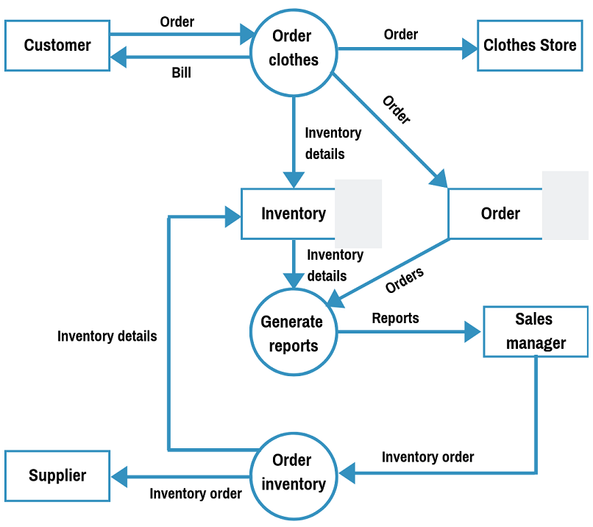
Visualize Your Data with Data Flow Diagrams
Data flow diagrams (DFDs) are a graphical representation of how data flows through a system.
DFDs can be used to identify potential bottlenecks in a system and to ensure that data is processed accurately and efficiently.
DFDs can be used in a variety of industries, including manufacturing, healthcare, and finance.
Notes:
Data flow diagrams (DFDs) are a powerful tool for visualizing how data flows through a system. DFDs can help you identify bottlenecks and inefficiencies in your system, and can help you design a more effective solution. DFDs can be used in a variety of industries, including manufacturing, healthcare, and finance. By using DFDs to map out your system, you can ensure that your data is processed accurately, efficiently, and securely.

